Slide 1
Building Cloud Networks
Narendra Maharjan

Slide 2
Managed service providers (MSP)
Managed service provider(MSP)
A managed service provider (MSP) is an outsourced third-party company that manages and assumes the responsibility of a defined set of day-to-day management services to its customers(server, network, specialized applications etc.).
It is a strategic method of improving operations that is commonplace among large corporations as well as small and medium-size businesses, non-profit organizations, and governments.

Slide 3
Managed service providers (MSP)
Managed service provider(MSP)
Managed service providers tend to be Web hosting or application service providers that allow users to outsource their network and application resource procedures under a delivery agreement.
In most cases, MSPs own the entire physical back-end infrastructure and provide resources to end users remotely over the Internet on a self-service, on-demand basis.
Eg. Sirius Computer Solutions, Inc. ,PCM Inc, Softchoice Corporation

Slide 4
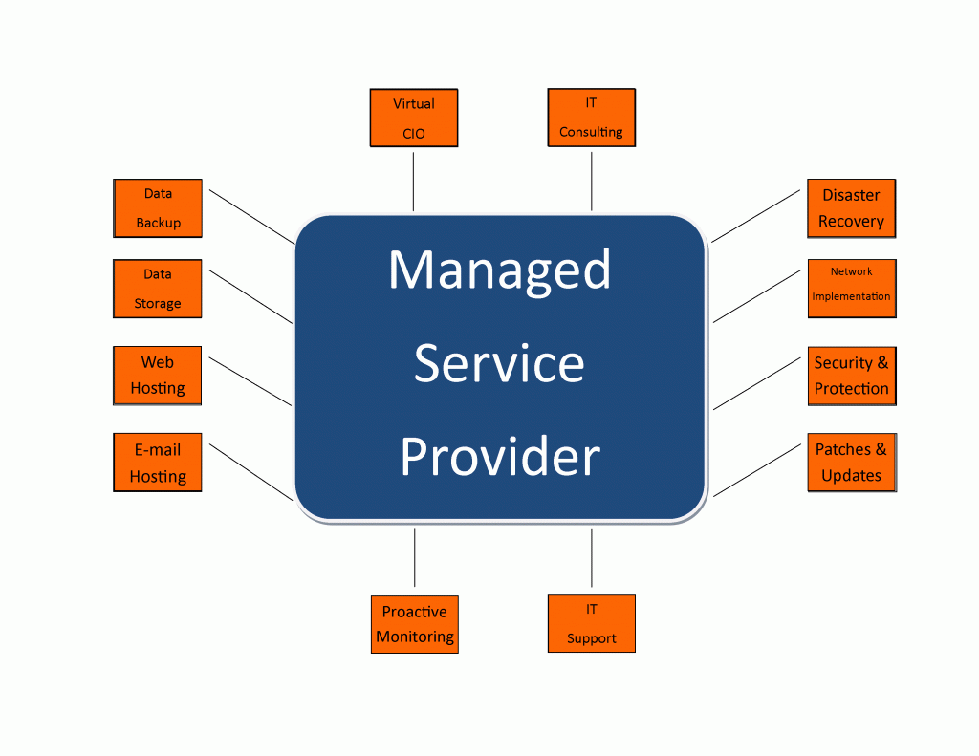

Slide 5
Evolution from Managed service providers (MSP) to Cloud Computing
The evolution of MSP started around the 1990s with the emergence of application service providers (ASPs) who helped pave the way for remote support for IT infrastructure.
From the initial focus of remote monitoring and management of servers and networks, the scope of an MSP's services expanded to include mobile device management, managed security, remote firewall administration

Slide 6
Evolution from Managed service providers (MSP) to Cloud Computing
The advance of cloud computing has added another complex blend of challenge and opportunity into the mix.
The biggest challenge is around finding ways to manage new hybrid environments, which combine the traditional on-premise world with new cloud-based infrastructures.
Cloud Computing enables organizations to consume compute resources as a utility, rather than having to build and maintain computing infrastructures in-house.

Slide 7
Evolution from Managed service providers (MSP) to Cloud Computing
In both Managed Services and Cloud Computing – regardless of whether it is Private or Public, there is a third-party entity that is providing a service to the consuming business entity.
This then leads to thoughts where organizations ponder if Managed Services is even relevant in the context of Cloud Computing.
As the cloud evolves, so will managed solutions in the cloud. It’s inevitable, as there are many positives to cloud computing, the bond between managed services and cloud computing will only strengthen in the years to come…

Slide 8
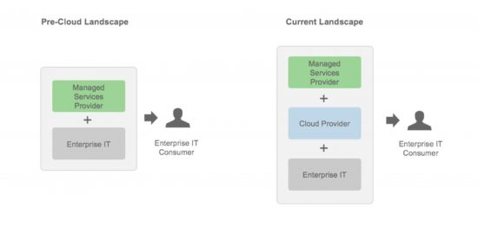
Evolution from Managed service providers (MSP) to Cloud Computing
The evolving role of Managed Service Providers with Cloud

Slide 9
From Single Purpose architectures to multi-purpose architectures
In the early days of MSPs, the providers would actually go onto customer sites and perform their services on customer-owned premises.
Over time, these MSPs specialized in implementation of infrastructure and quickly figured out ways to build out data centres and sell those capabilities off in small chunks commonly known as monthly recurring services, in addition to the basic fees charged for ping, power, and pipe (PPP).
Ping refers to the ability to have a live Internet connection,
power is obvious enough, and
pipe refers to the amount of data throughput that a customer is willing to pay for.

Slide 10
Contd..
An advantage for customers using an MSP is that by purchasing a defined set of services, MSPs bill a flat or near-fixed monthly fee.
Step forward to today and we find that many MSPs now provide their services remotely over the Internet rather than having to sell data centre space and services or perform on-site client visits (which is time-consuming and expensive).

Slide 11
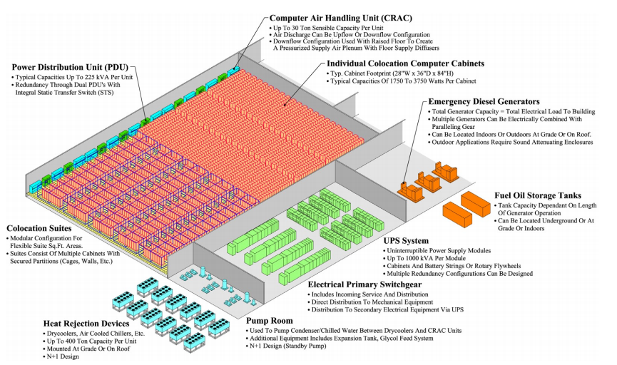
Datacenters
Servers?
Notes:
Datacenters powering Internet services are no longer simply a miscellaneous collection of machines co-located in a facility and wired up together.
The software running on these systems, such as Gmail or Web search services, execute at a scale far beyond a single machine or a single rack.
Datacenters are essentially very large devices that consume electrical power and produce heat. The
datacenter’s cooling system removes that heat—consuming additional energy in the process, whose
heat must be removed as well.

Slide 12
Data Center Virtualization
Data centre virtualization is the process of designing, developing and deploying a data centre on virtualization and cloud computing technologies.
It primarily enables virtualizing physical servers in a data centre facility along with storage, networking and other infrastructure devices and equipment. Data centre virtualization usually produces a virtualized, cloud and collocated virtual/cloud data centre.
Virtual Sever resides on top of hypervisor also known as virtual Machine Manager(VMM)

Slide 13
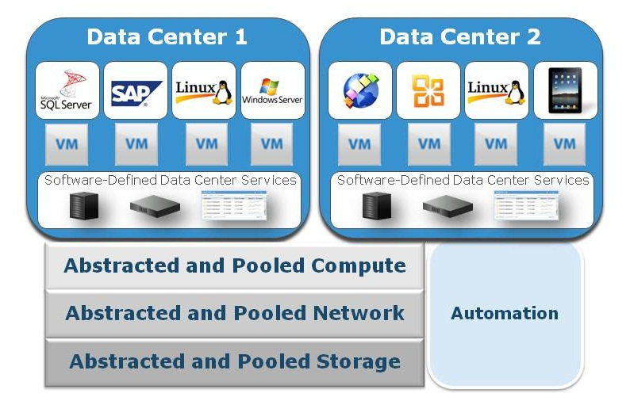

Slide 14
Data Center Virtualization benefits
Less heat build up
Millions of dollars have gone into the research and design of heat dissipation and control in the data centre. But the cold, hard fact is, all of those servers generate heat. The only way around that? Use fewer servers. How do you manage that? Virtualization. Virtualize your servers and you're using less physical hardware. Use less physical hardware and you generate less heat.
Reduced cost
Hardware is most often the highest cost in the data centre. Reduce the amount of hardware used and you reduce your cost. But the cost goes well beyond that of hardware — lack of downtime, easier maintenance, less electricity used. Over time, this all adds up to a significant cost savings.

Slide 15
Data Center Virtualization benefits
Faster redeploy
When you use a physical server and it dies, the redeploy time depends on a number of factors: Do you have a backup server ready? Do you have an image of your server? Is the data on your backup server current? With virtualization, the redeploy can occur within minutes. Virtual machine snapshots can be enabled with just a few clicks. And with virtual backup tools like Veeam, redeploying images will be so fast your end users will hardly notice there was an issue.
Easier backups
Not only can you do full backups of your virtual server, you can do backups and snapshots of your virtual machines. These virtual machines can be moved from one server to another and redeployed easier and faster. Snapshots can be taken throughout the day, ensuring much more up-to-date data. And because firing up a snapshot is even faster than booting a typical server, downtime is dramatically cut.

Slide 16
Data Center Virtualization benefits
Better testing
What better testing environment is there than a virtual one? If you make a tragic mistake, all is not lost. Just revert to a previous snapshot and you can move forward as if the mistake didn't even happen. You can also isolate these testing environments from end users while still keeping them online. When you've perfected your work, deploy it as live.
No vendor lock-in
One of the nice things about virtualization is the abstraction between software and hardware. This means you don't have to be tied down to one particular vendor — the virtual machines don't really care what hardware they run on, so you're not tied down to a single vendor, type of server (within reason of course), or even platform.

Slide 17
Service Oriented Architectures
A service is a unit of work done by a service provider to achieve desired end results for a service consumer.
“A service-oriented architecture is essentially a collection of services. These services communicate with each other.
An SOA involves policies, principles, and a framework that illustrate how network services can be leveraged by enterprise applications to achieve desired business outcomes.
These outcomes include enabling the business capabilities to be provided and consumed as a set of services.
Notes:
Leveraged(to gain advantage)

Slide 18
Service Oriented Architectures
SOA is much more than a technological approach and methodology for creating IT systems. It’s also a business approach and methodology. Companies have used the principles of SOA to deepen the understanding between the business and IT and to help business adapt to change.
An SOA solution consists of a linked set of business services that realize an end-to-end business process. At a high level, SOA can be viewed as enabling improved management control, visibility, and metrics for business processes

Slide 19
Service Oriented Architectures
Services most often reflect logical business activities. Some means of connecting services to each other is needed, so services communicate with each other, have an interface, and are message-oriented.
The communication between services may involve simple data passing or may require two or more services coordinating an activity.
The first service-oriented architectures are usually considered to be the Distributed Component Object Model (DCOM) or Object Request Brokers (ORBs), which were based on the Common Object Requesting Broker Architecture (CORBA) specification.
The introduction of SOA provides a platform for technology and business units to meet business requirements of the modern enterprise.

Slide 20
Service Oriented Architectures
Differentiating between SOA and cloud computing can be confusing because they overlap in some areas but are fundamentally different.
SOA delivers web services from applications to other programs, whereas the cloud is about delivering software services to end users and running code.
Notes:
Leveraged(to gain advantage)

Slide 21
SOA
One of the key benefits of a service oriented approach is that software is designed to reflect best practices and business processes instead of making the business operate according to the rigid structure of a technical environment.
A service-oriented architecture is essentially a collection of services. A service is, in essence, a function that is well defined, self-contained, and does not depend on the context or state of other services.

Slide 22
SOA Actors
Service Provider
From a business perspective, this is the owner of the service. From an architectural perspective, this is the platform that provides access to the service.
Service Registry
This is an information space of service descriptions where service providers publish their services and service requesters find services and obtain binding information for services.
Allows service consumers to locate service providers that meet required criteria
Service Consumer
From a business perspective, this is the business that requires certain function to be fulfilled. From an architectural perspective, this is the client application that is looking for and eventually invoking a service.

Slide 23
Cloud Data Center

